Slide 1
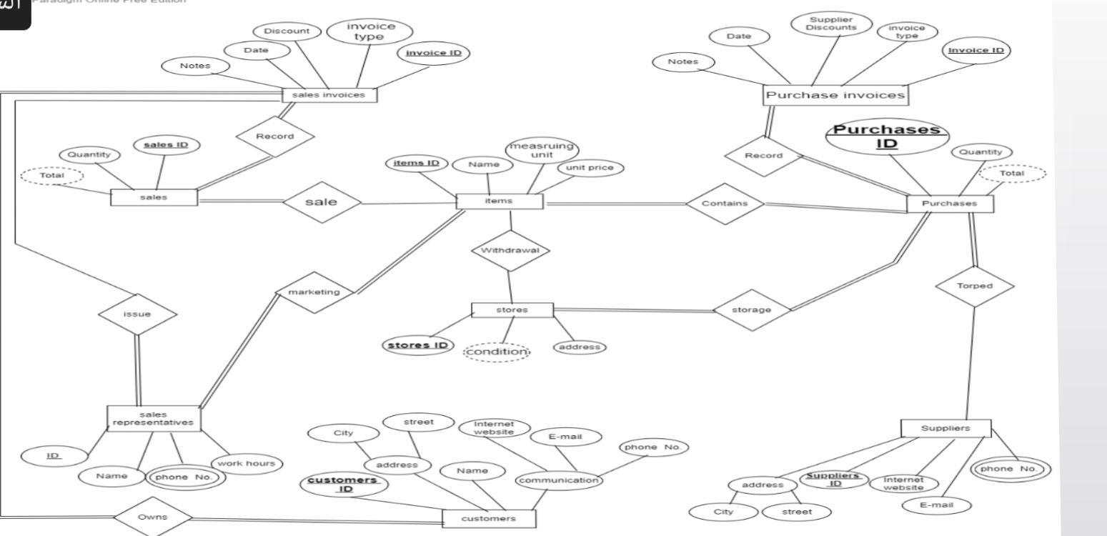

Slide 2
Normalization
1Supplier (Supplier ID,E-mail ,phone no,internet website,address)
2customers(customer ID ,name ,E-mail ,phone no ,address)
3sales invoices (invoices id ,data ,notes,discount,invoice type)

Slide 3
Normalization one 1st
1Suppliers(Supplies id , E-mail,internet website,address)
2Phone suppliers ( suppliers id , Phone)
3customers (customer id ,name, E-mail ,address)
4phone customer (phone no , customer id)
5sales invoices ( invoice id , date, notes , discount, invoice type)

Slide 4
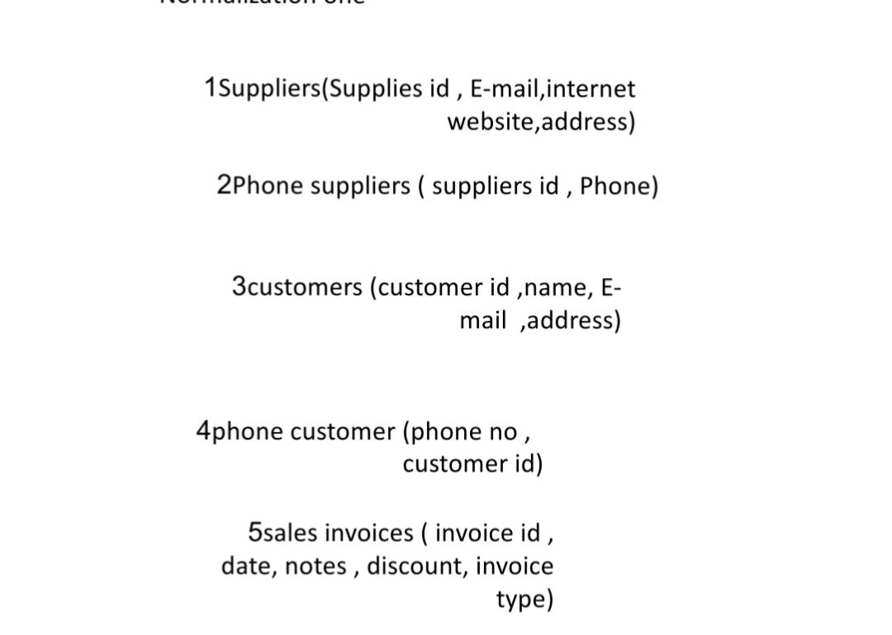
Normalization two 2st

Slide 5
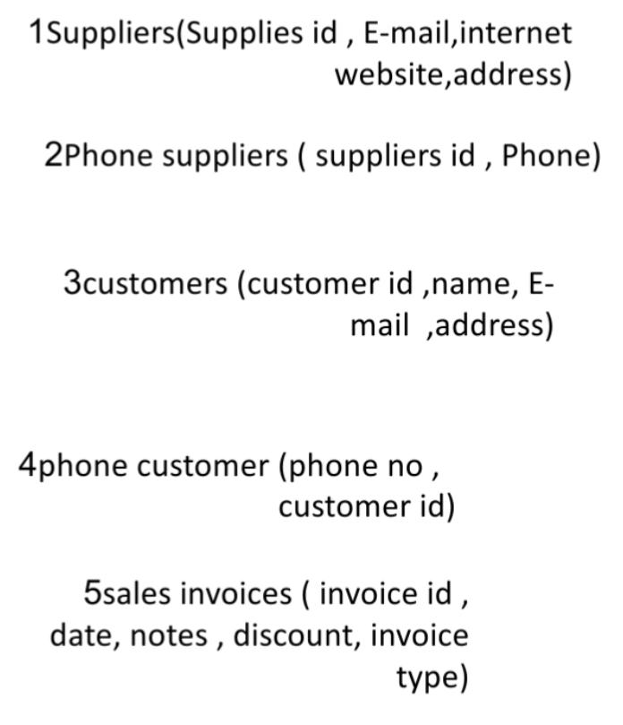
Normalization three 3st

